Slide 1





Spotify Global Streaming Analysis 2024 (EDA)
Under the Guidance of :
Anil Waded
(Data Science Trainer - SIVA Academy)
By :
Anjana G Nadig

Slide 2


Project Overview
Dataset: Spotify 2024 Global Streaming Data (CSV, 2024).
Key fields: Country, Artist, Album, Year, Monthly Listeners, Total Streams, Hours Streamed, Stream Duration, Platform Type, Skip Rate, Genre.
Goal: Reveal regional streaming patterns, artist impact, and user behaviors.
Tools: Python, PySpark, Pandas ,Seaborn, Matplotlib for analysis and visuals.
www.sivaacademy.net

Slide 3
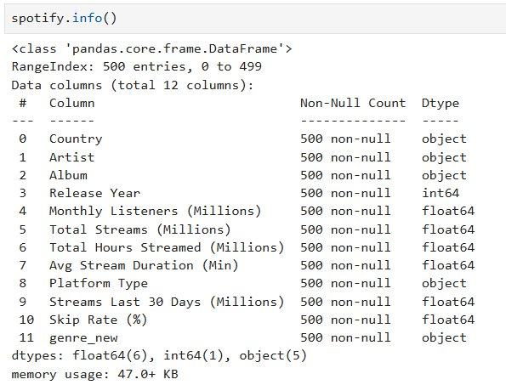
Data Overview
The dataset comprises 500 observations across 12 well-defined features, with no missing values, ensuring data completeness for analysis. During preprocessing, the original Genre column was found to be mismatched. To address this, we remapped the correct genres to their respective albums and artists and created a new Genre column for accurate analysis.
www.sivaacademy.net
Notes:
After ensuring the data quality through preprocessing, moving ahead with analysis of streaming patterns, artists, and genres.”

Slide 4
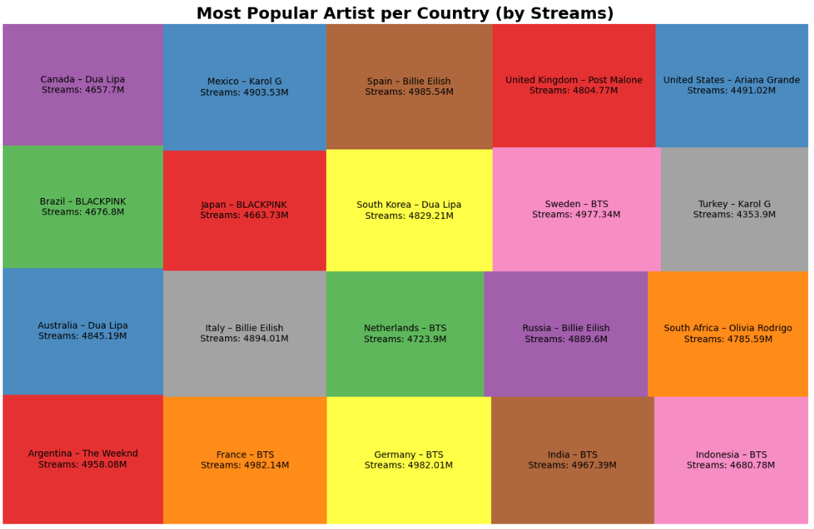
The Most Popular Artist in Each Country
The treemap highlights each country’s top artist by total streams.
Larger blocks show stronger market dominance.
This gives a clear view of artists and global streaming patterns revealing where artists hold greatest influence.
www.sivaacademy.net

Slide 5
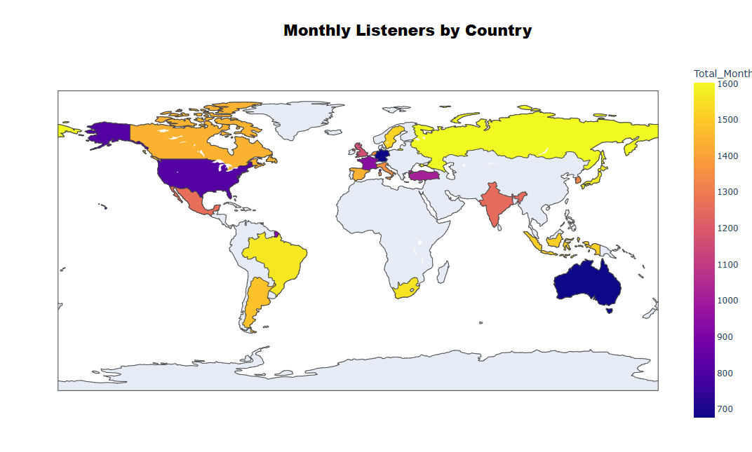
Monthly Listeners by Country
Shows the total monthly listeners per country, highlighting global streaming distribution.
Darker colors indicate higher listener counts, highlighting top Spotify audiences.
Gives insights into market size and artist reach across countries.
www.sivaacademy.net

Slide 6
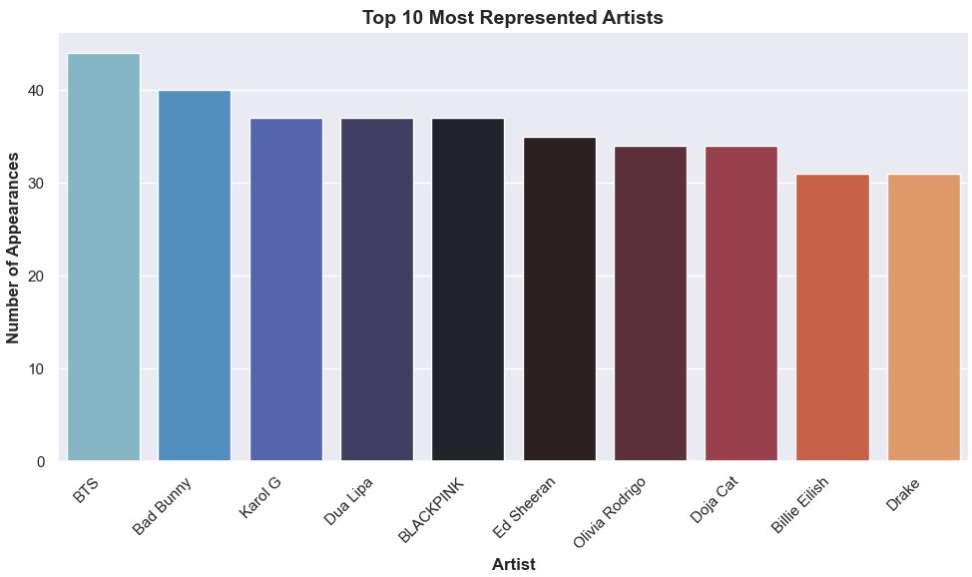
Most Represented Artists
Displays the artists who appear most frequently in the dataset.
Highlights the top artists dominating the charts, led by BTS, Bad Bunny, and Karol G, followed by others.
Provides insights into recurring popularity and influence across tracks globally.
www.sivaacademy.net

Slide 7
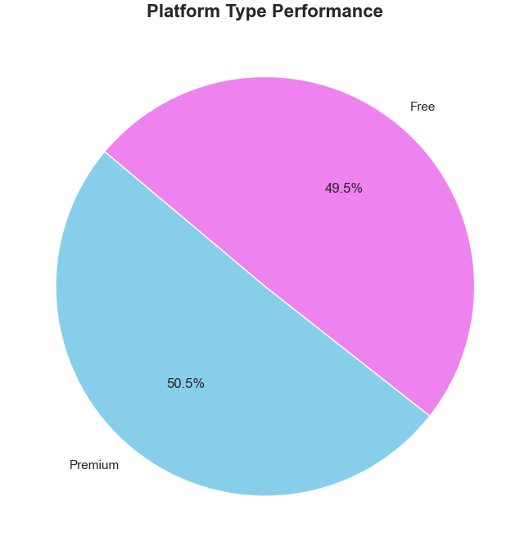
Platform Type Performance
Comparison of Spotify Free and Spotify Premium streaming contributions.
Premium users dominate the total streams, reflecting stronger engagement and loyalty.
www.sivaacademy.net

Slide 8
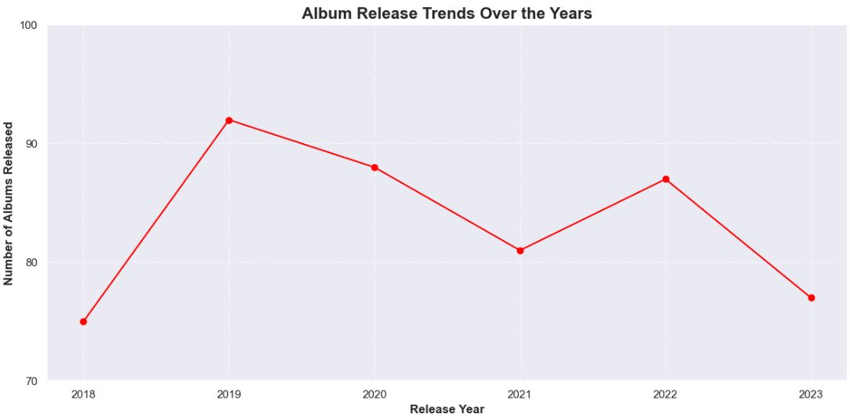
Album Release Trends
Shows how the number of albums released has evolved across different years.
Highlights peak release periods, indicating times of higher music activity.
Provides insights into industry dynamics and artist productivity over time.
www.sivaacademy.net

Slide 9
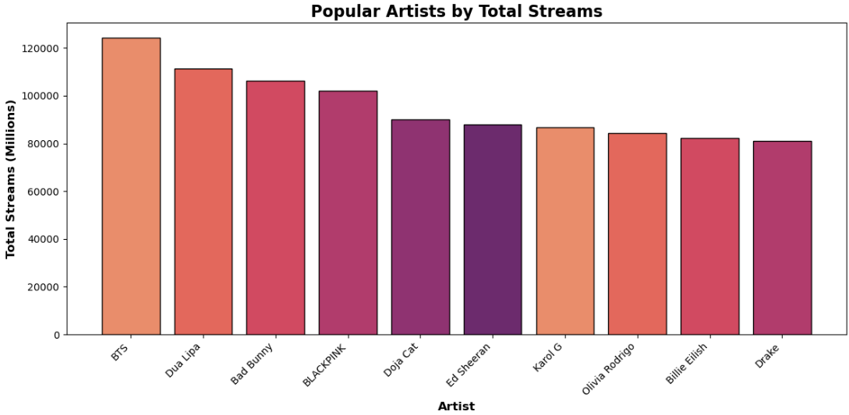
Popular Artist
The analysis highlights leading artists on Spotify in 2024.
Based on the visual, BTS emerges as the most popular artist, followed by Dua Lipa and Bad Bunny in total streams.
This ranking reflects not just total streams but also broader audience reach, capturing the true influence of each artist
www.sivaacademy.net

Slide 10
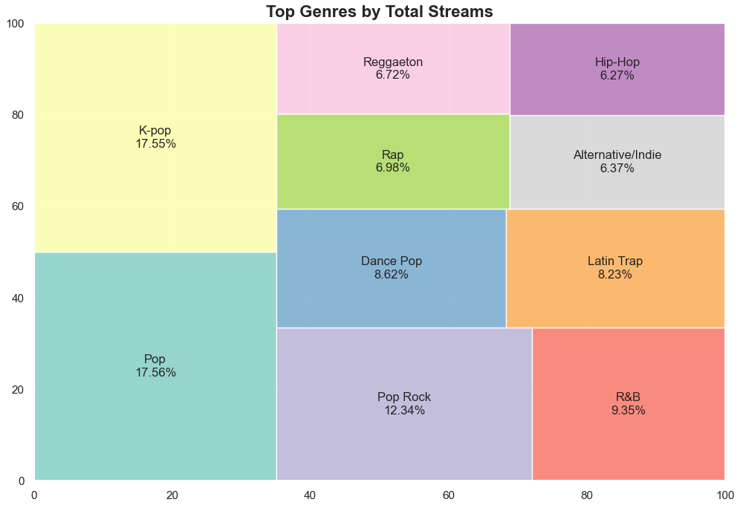
Top Genres by Total Streams
Total streams reflect the absolute popularity of genres across all tracks.
Analysis shows Pop as the leading global genre in 2024, followed by K-Pop and Pop Rock.
This provides a big-picture view of how cultural and regional tastes are shaping Spotify’s streaming trends.
www.sivaacademy.net

Slide 11
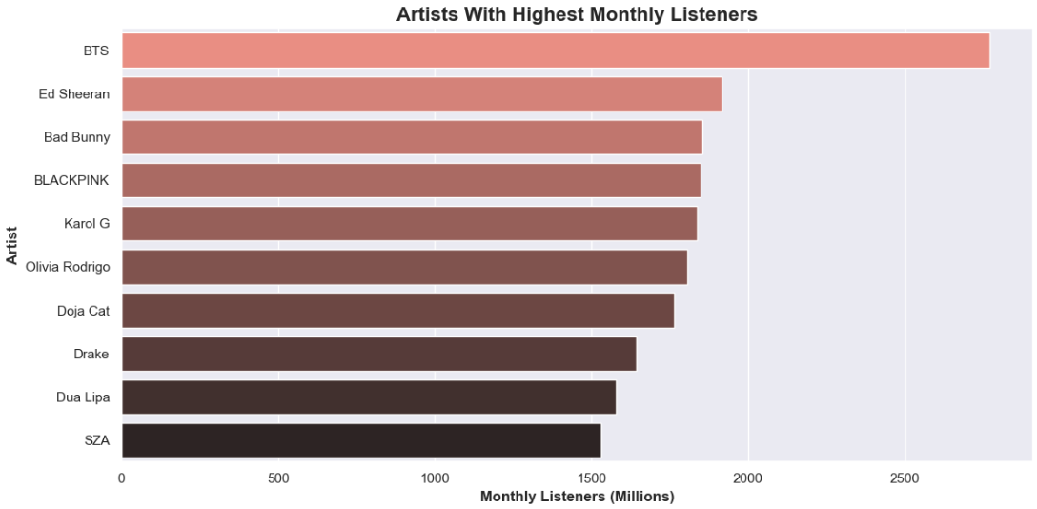
Highest Monthly Listeners
Monthly listeners are a strong indicator of an artist’s active audience base.
Unlike total streams, which can be boosted by a single hit, monthly listeners reflect consistent popularity across time.
BTS leads in monthly listeners, followed by Ed Sheeran and Bad Bunny, reflecting strong and sustainable fanbases.
www.sivaacademy.net

Slide 12
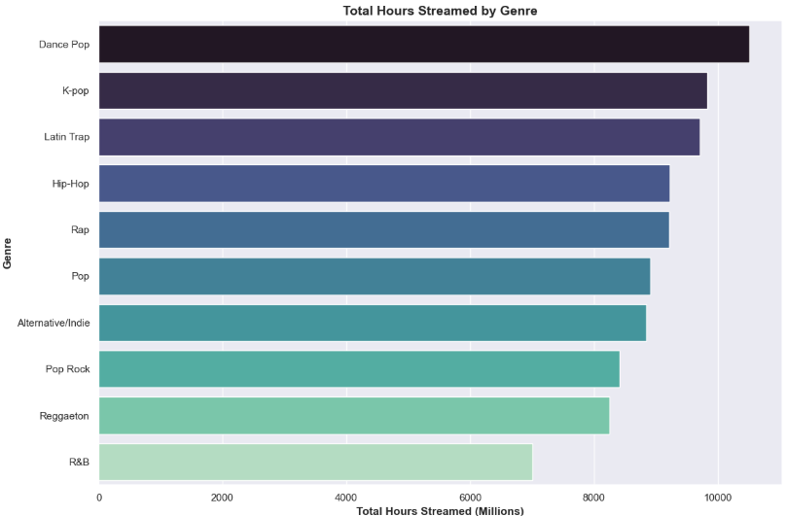
Popular Genre
Average stream duration tells us how long listeners stay tuned to songs of a particular genre.
Longer stream durations reflect deeper listener engagement, led by Dance Pop, followed by K-Pop, Latin Pop, and Hip Hop.
www.sivaacademy.net

Slide 13
Conclusion
This gives us a clear picture of how global streaming patterns vary across countries, platforms, artists, and genres. Pop, K-Pop, and Dance Pop dominate worldwide, with BTS, Dua Lipa, and Bad Bunny leading the charts. These trends highlight opportunities for targeted promotions and personalized content.
www.sivaacademy.net
Notes:
“That concludes my presentation on Spotify Global Streaming Analysis 2024. Thank you for your time.”

Slide 14

Thank You

